Slide 1

COMPUTER AIDED DIAGNOSIS OF PANCREATIC TUMOR BASED ON CT IMAGES
SRM INSTITUTE OF SCIENCE AND TECHNOLOGY
SCHOOL OF COMPUTING
DEPARTMENT OF COMPUTING TECHNOLOGIES
18CSP107L - MINOR PROJECT
Guide name: DR.A.M.J.Muthukumaran
Designation: Assistant Professor Department: Computing Technologies
Batch ID: B321
Student 1 Reg. No:RA2011003010416
Student 1 Name: Kasanur Jyothiradhithya
Student 2 Reg. No:RA2011003010892
Student 2 Name: N. MD. Atahar Hajee

Slide 2
Abstract:
CT scans of the pancreas can provide more detailed information about the pancreas than regular X-rays of the belly. If your healthcare provider is looking for pancreatic cancer, a special CT scan might be ordered. This is called a multi-phase CT scan or a pancreatic protocol CT scan.
Since the Convolutional Neural Network (CNN) was applied to visual data analysis, there has been great progress in deep learning, computer vision and medical image processing.
There is the potential to apply deep learning-based approaches on medical image analysis, such as the tumor detection of pancreatic tumor. Pancreatic tumor is one of a malignant tumor diseases.
These techniques leverage large datasets of medical images, often obtained through CT scans, to train deep neural networks capable of identifying subtle patterns indicative of tumors.

Slide 3
Introduction:
The pancreas is a small organ located in the deep of human body, so that the difficulty of detection is significantly increased. Furthermore, missing the optimal time for radical surgery is the major cause of cancer death.
Nevertheless, manually diagnosing requires doctors with rich clinical experience, because the quality of CT images varies between different CT scanners or operators, and pathological texture features are hard to be distinguished. Therefore, there is a growing need of studying on proposing a robust deep-learning-based algorithm for accurate pancreatic tumor detection.
Pancreatic cancer isn't common, but it is one of the deadliest types of cancer. That's because symptoms usually don't surface until the cancer is already in late stages, making it difficult to treat.
Pancreatic cancer occurs when cells in your pancreas mutate (change) and multiply out of control, forming a tumor.

Slide 4
Existing systems:
Medical History and Symptoms: Doctors start by asking the patient about their medical history, including any symptoms they might be experiencing. Common symptoms of pancreatic tumors can include abdominal pain, weight loss, jaundice (yellowing of the skin and eyes), digestive issues, and changes in bowel habits.
Laparoscopy: Laparoscopic surgery may be performed to visually inspect the pancreas and surrounding tissues, and to take tissue samples for biopsy.
Physical Examination: A physical examination can help doctors identify any visible signs of jaundice or abdominal masses.
Imaging Tests: Various imaging tests are used to visualize the pancreas and any abnormalities. These may include CT Scans.

Slide 5
Limitations in existing systems:
Late Detection: Pancreatic cancer is often diagnosed at an advanced stage because symptoms typically appear late in the disease. Early detection is challenging using traditional methods.
Interobserver Variability: Human interpretation of medical images can vary from one radiologist to another, potentially leading to inconsistent results.
Efficiency: Reviewing a large number of medical images can be time-consuming for healthcare professionals, leading to delays in diagnosis.
False Positives and Negatives: Traditional methods may result in false positives (incorrectly identifying a tumor) or false negatives (missing tumor).

Slide 6
Proposed Systems:
To detect pancreatic tumor from CT scan images. These images are preprocessed using image processing techniques and then CNN model architecture is used to classify the tumor area in the image.
The classification is done using CNN model architecture. In this, the system is made learn according to the classes defined in the image
We train a CNN using contrast enhanced-CT images of patients to distinguish pancreatic cancer from healthy pancreases.

Slide 7
Advantages of proposed system:
In the context of detecting pancreatic tumors from medical images like CT scans, CNNs can offer several advantages:
Feature Extraction: CNNs automatically learn relevant features from the input images without the need for manual feature engineering. This is especially beneficial in medical imaging, where identifying subtle patterns can be challenging.
Adaptation: CNNs can be trained on large datasets, allowing them to learn from a diverse range of cases and adapt to variations in tumor appearance.
Early Detection: CNNs can potentially assist in the early detection of tumors, helping improve patient outcomes by catching tumors at more treatable stages.
Consistency: CNNs are less prone to human error and fatigue, potentially leading to more consistent results in tumor detection.

Slide 8
Problem statement and objectives:
1. Data Collection and Preprocessing: Gather comprehensive data from various sources. Preprocess the data to make it suitable for training and testing machine learning models.
2. Model Selection: Choosing various machine learning algorithms, including regression models, deep learning models, to determine the most suitable approach for accurate range prediction.
3. Training and Validation: Divide the dataset into training, validation, and test sets. Train the selected model(s) on the training data, refining main parameters to optimize performance. Use the validation set to monitor and prevent overfitting.
4. Testing and Evaluation: Evaluate the model's accuracy, precision, and recall using the test dataset.

Slide 9
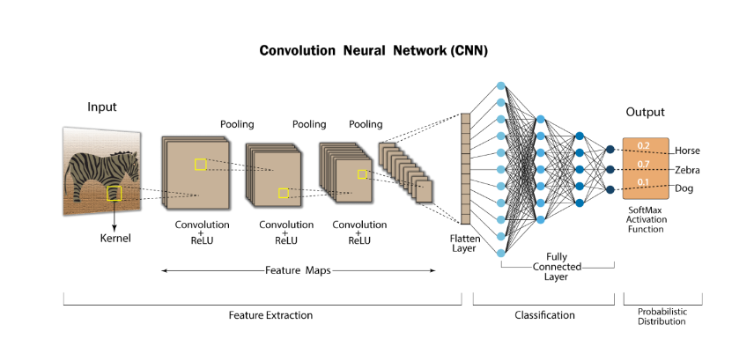
Convolutional Neural Network:

Slide 10
CNN Layers:
Convolutional Layers: These layers apply a set of learnable filters to the input data. These filters slide or convolve across the input to detect various features, such as edges, corners, and textures. Convolutional layers are the core of CNNs and consist of multiple convolutional filters.
Activation Layers: After each convolutional operation, an activation function, often ReLU (Rectified Linear Unit), is applied element-wise to introduce non-linearity into the model.
Pooling Layers: Pooling layers reduce the spatial dimensions of the data by down-sampling, typically through operations like max-pooling or average-pooling. This reduces the computational load and makes the network more robust.
Fully Connected (Dense) Layers: These layers connect all neurons from the previous layer to all neurons in the current layer, essentially forming a densely connected neural network. Fully connected layers are usually used in the later stages of the network for classification tasks.
Flattening Layer: In between convolutional and fully connected layers, a flattening layer reshapes the data from a multi-dimensional form into a flat vector that can be fed into the fully connected layers.

Slide 11
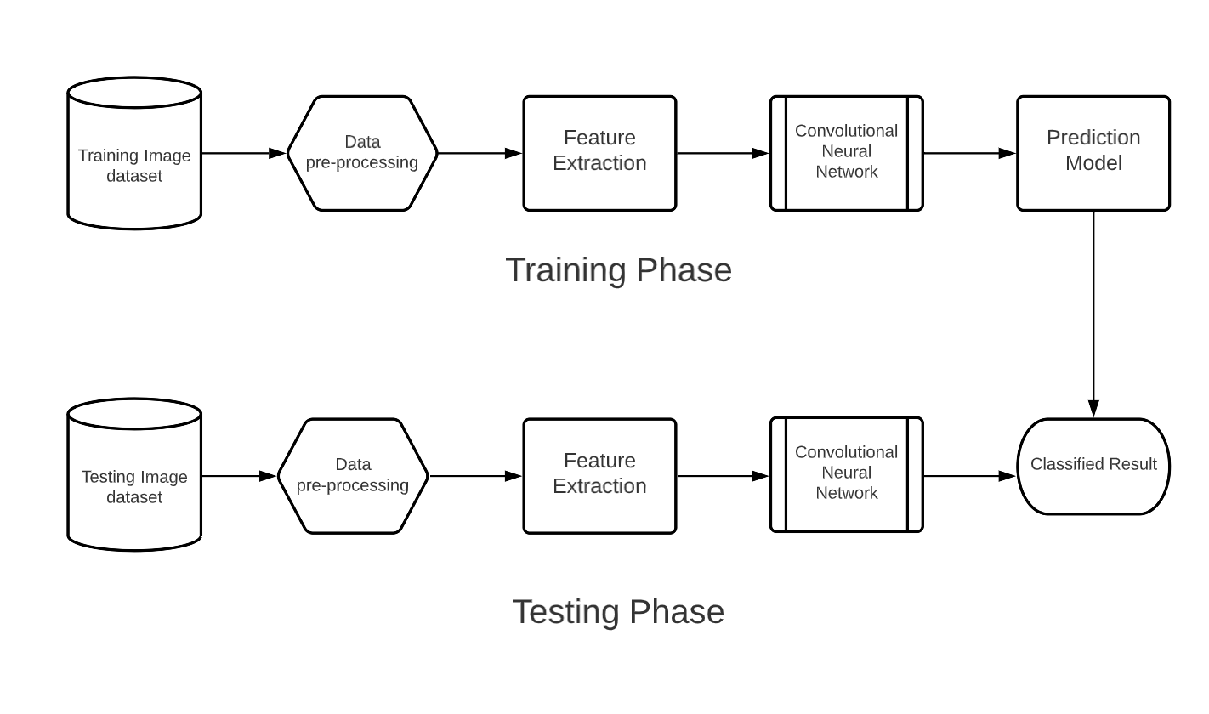
Proposed System Architecture:

Slide 12
Modules Description:
Data set : An image dataset is a collection of images used for training, validation, or testing in machine learning and computer vision applications.
Data Pre-processing: The goal of image preprocessing is to enhance the quality of the images, extract relevant information, and prepare them for effective and accurate processing.
Feature Extraction: Feature extraction is the process of transforming raw data into a reduced and meaningful representation of its most important characteristics for further analysis.
CNN: A Convolutional Neural Network (CNN) is a deep learning architecture designed for image and spatial data that uses convolutional layers to automatically learn hierarchical features by doing Training, Validating and Testing

Slide 13
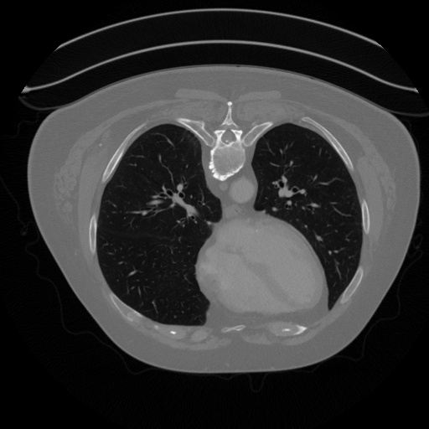
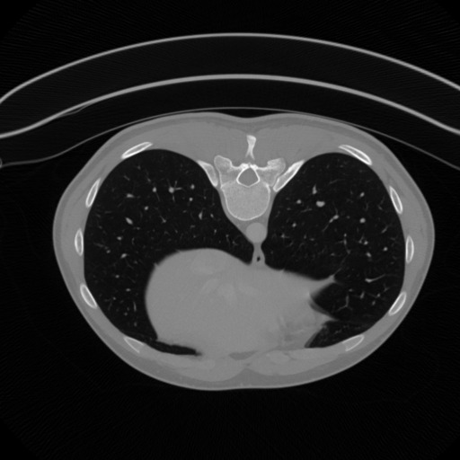
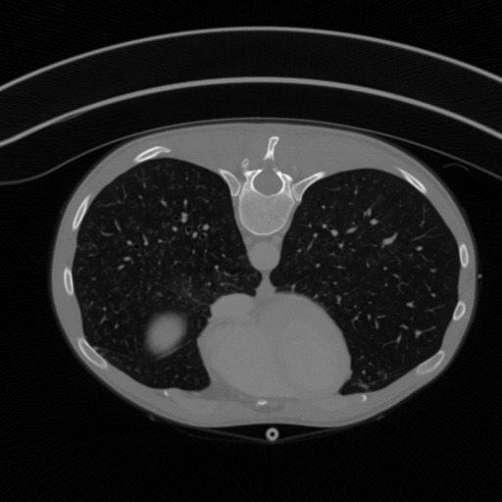
Dataset:
Normal data:

Slide 14
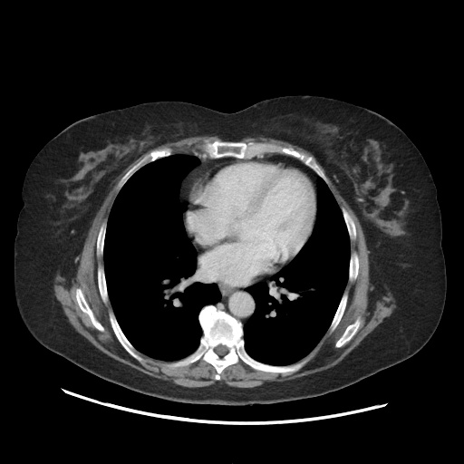
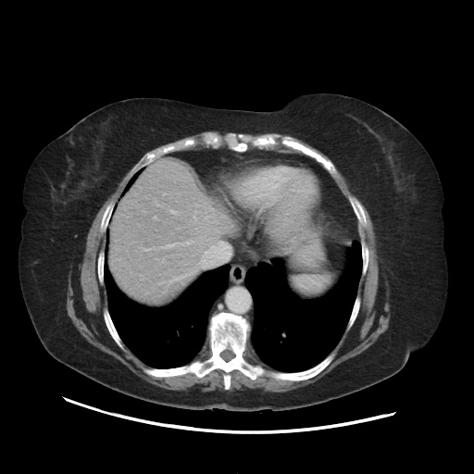
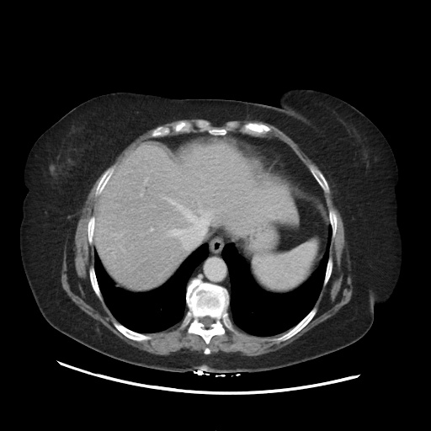
Dataset:
Tumor data:

Slide 15
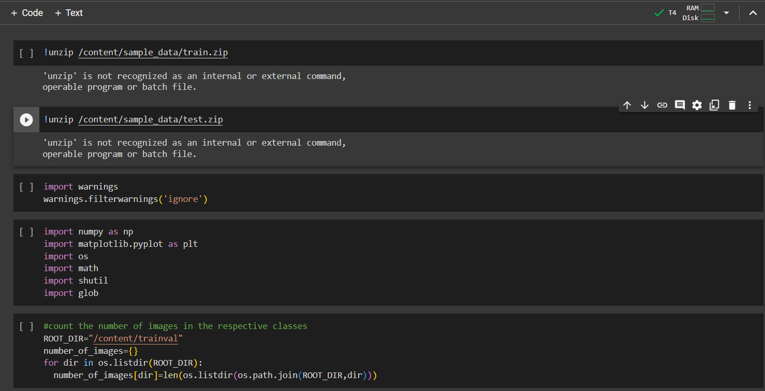
Code:

Slide 16
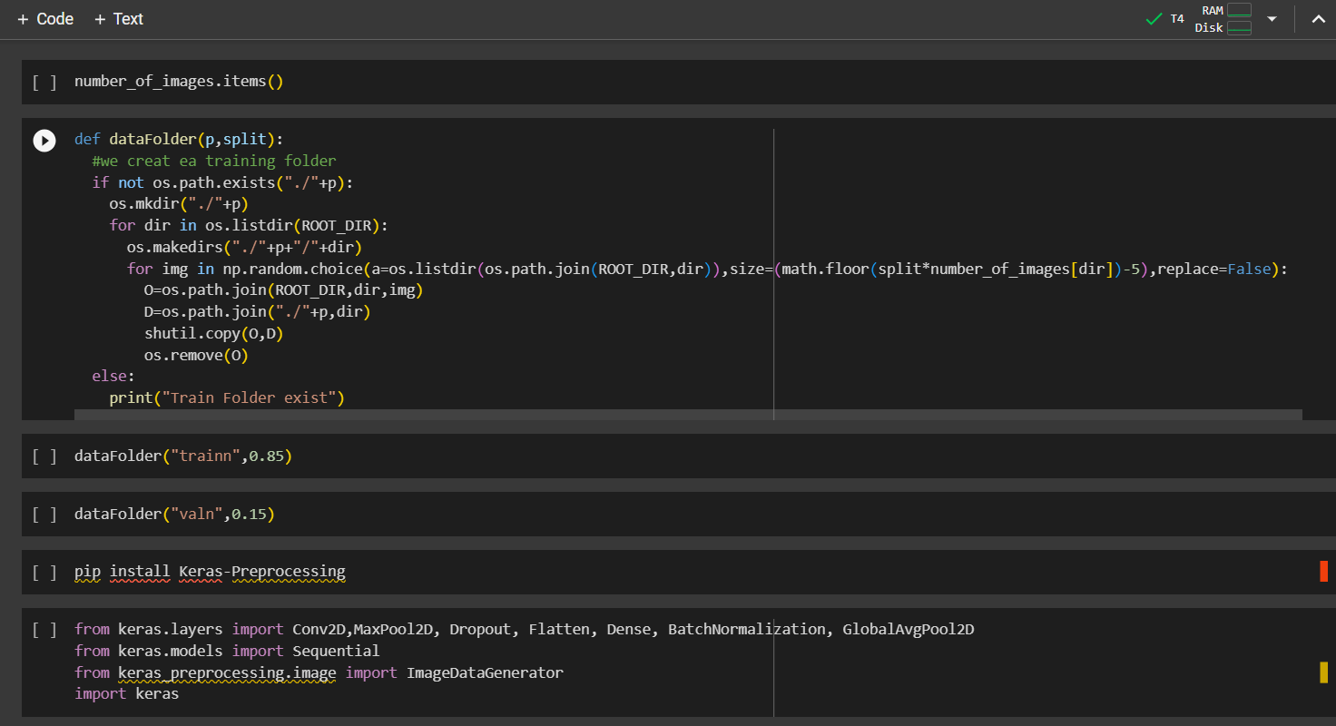
Code:

Slide 17
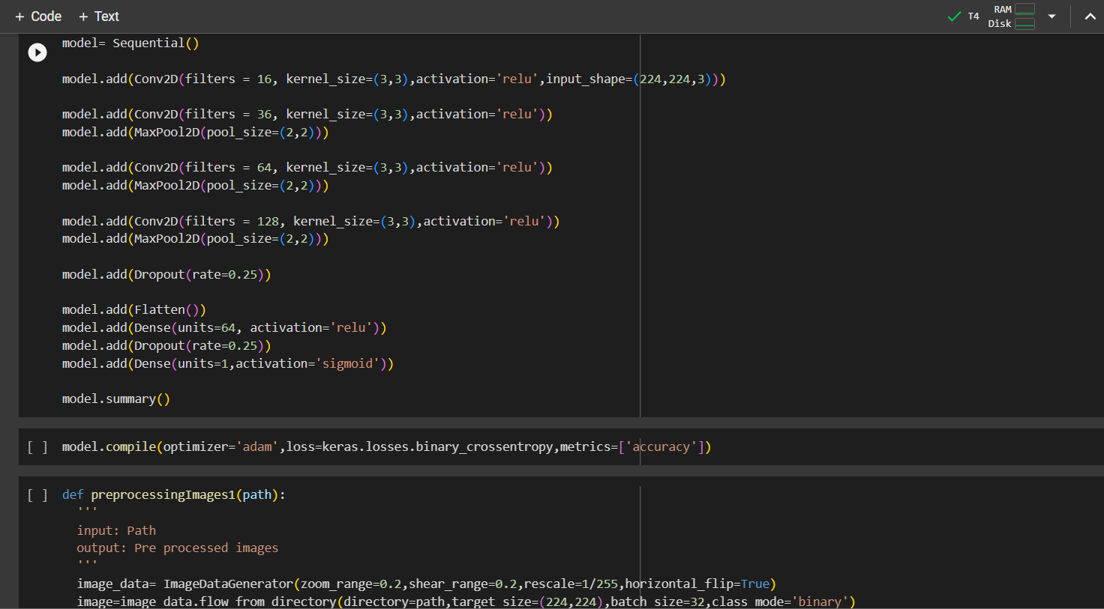
Code:

Slide 18
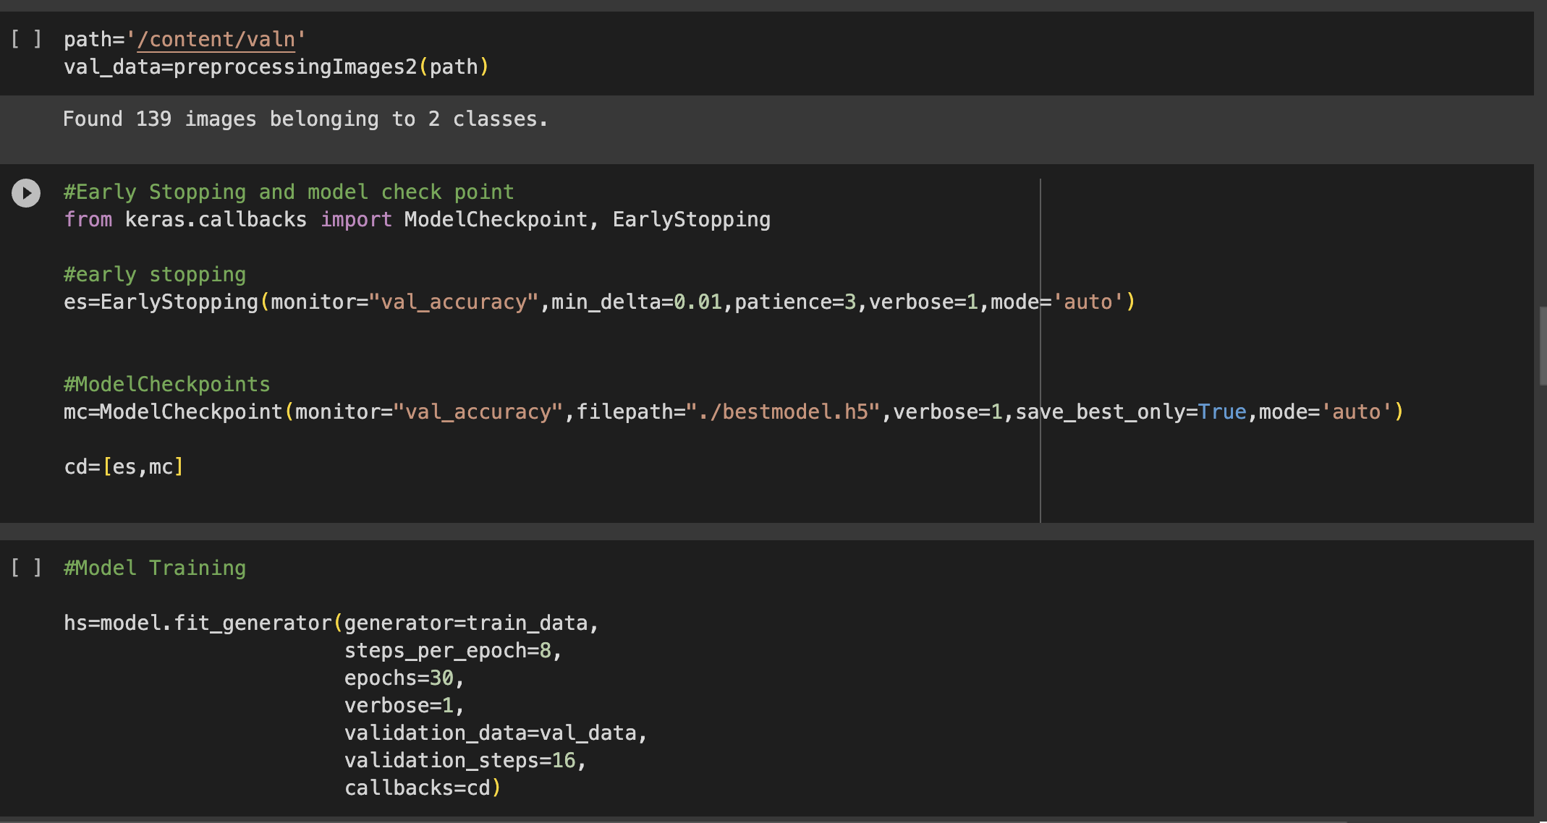

Slide 19
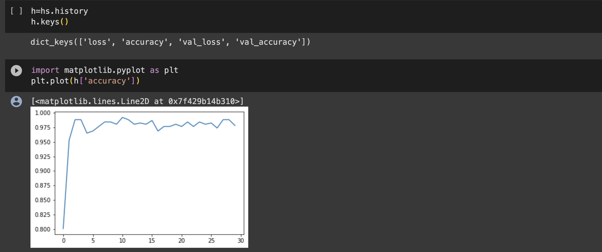

Slide 20
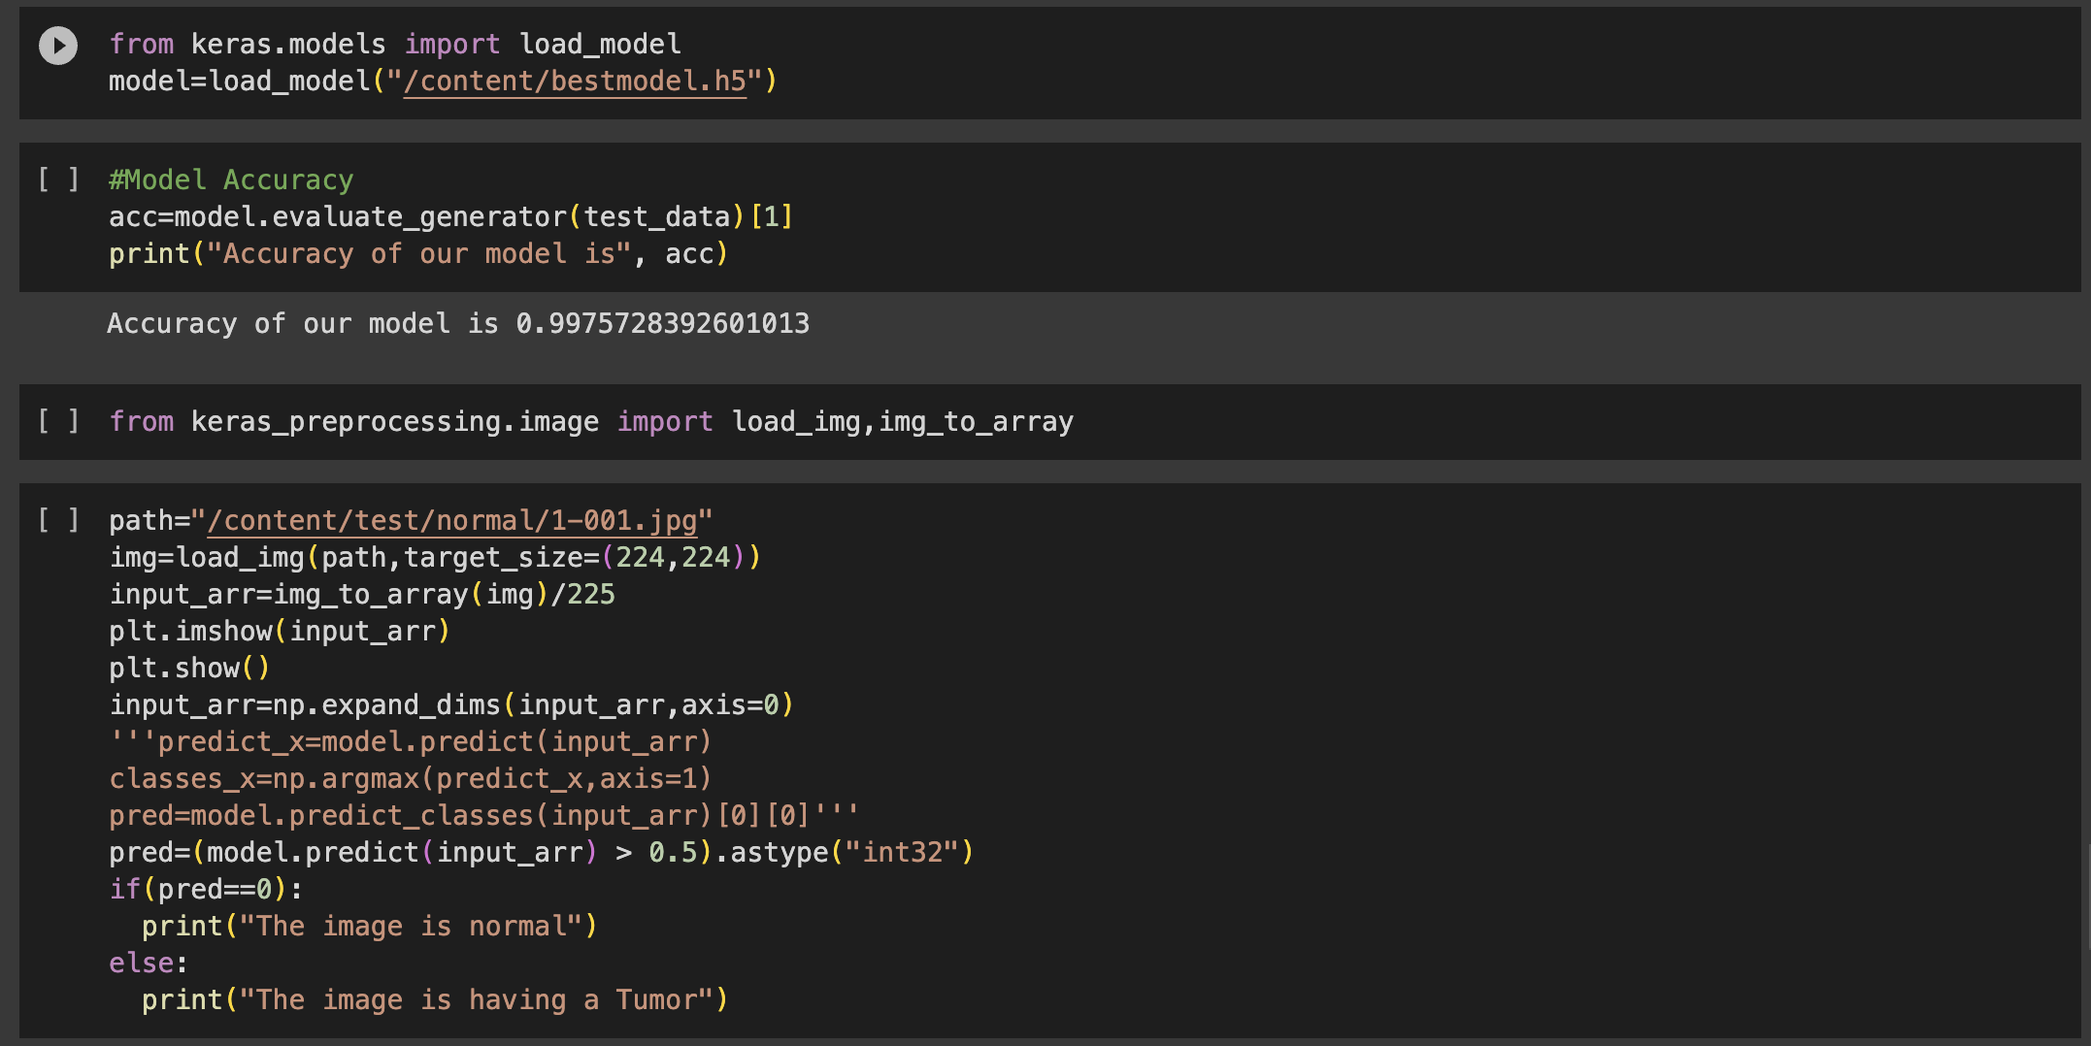

Slide 21
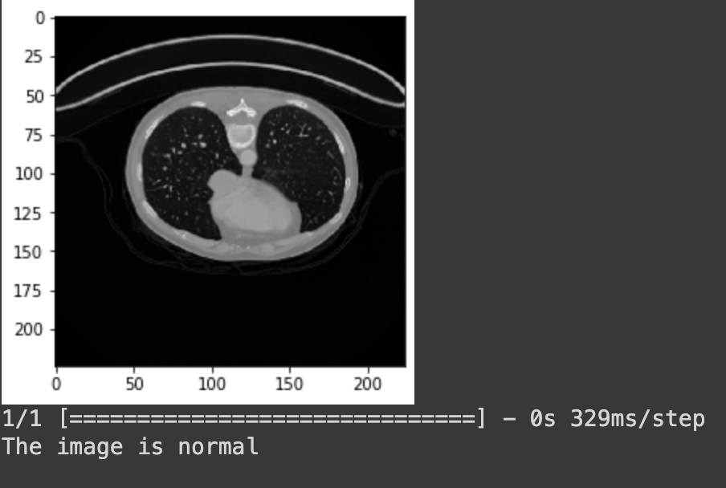
OUTPUT:

Slide 22
References:
Computer-Aided Diagnosis and Staging of Pancreatic Cancer Based on CT Images journal published on July 30, 2020.
Harmonic Motion Imaging for Abdominal Tumor Detection and High-Intensity Focused Ultrasound Ablation Monitoring journal published on September 2015.
Automatic Segmentation of Pancreas and Pancreatic Tumor journal published on 8th September 2023.

Slide 23
THANK YOU

